Slide 1
Simulation

Slide 2
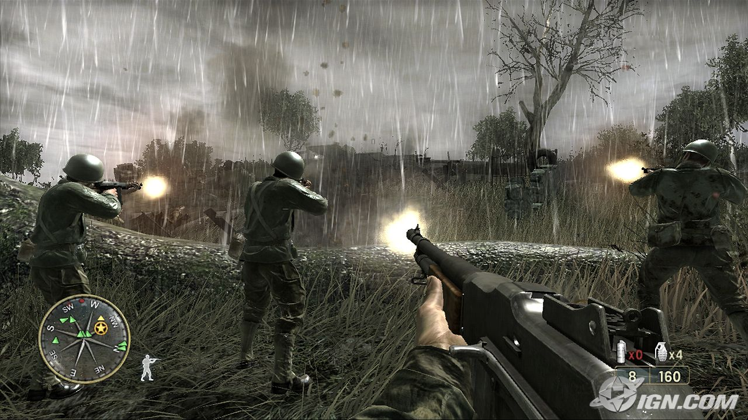
Games are often a kind of simulation

Slide 3
Mimesis
Most arts are imitative or mimetic: they are imitations of nature
There are alway exceptions
Painting is a mimetic art
But there are still non-figurative paintings
The process of imitation is called mimesis
Games are an imitative art
But they’re more like theater than painting
They’re processes that unfold in time
So simulation is one of their modes of mimesis

Slide 4
No simulation is ever perfect
We don’t actually know what reality is
People writing “accurate” physics sims in 1400, 1800, and today would write sims with very different behavior
Our simulations couldn’t include abstractions like tables, chairs, and humans
They’d just have quarks and other subatomic particles

Slide 5
Representation and abstraction
But wait, if tables don’t technically exist, are we living in a fantasy?
No, we’re thinking in terms of representations that are useful approximations
But it does mean that a lot of our thinking is (necessarily) disconnected from the details of reality

Slide 6
Representation and abstraction
Any simulation necessarily abstracts the processes it models
They simplify away details that aren’t relevant to the problem at hand
Games are especially abstracted to keep things simple and predictable
And tabletop games even more so
Since people have to do the simulation rather than computers

Slide 7
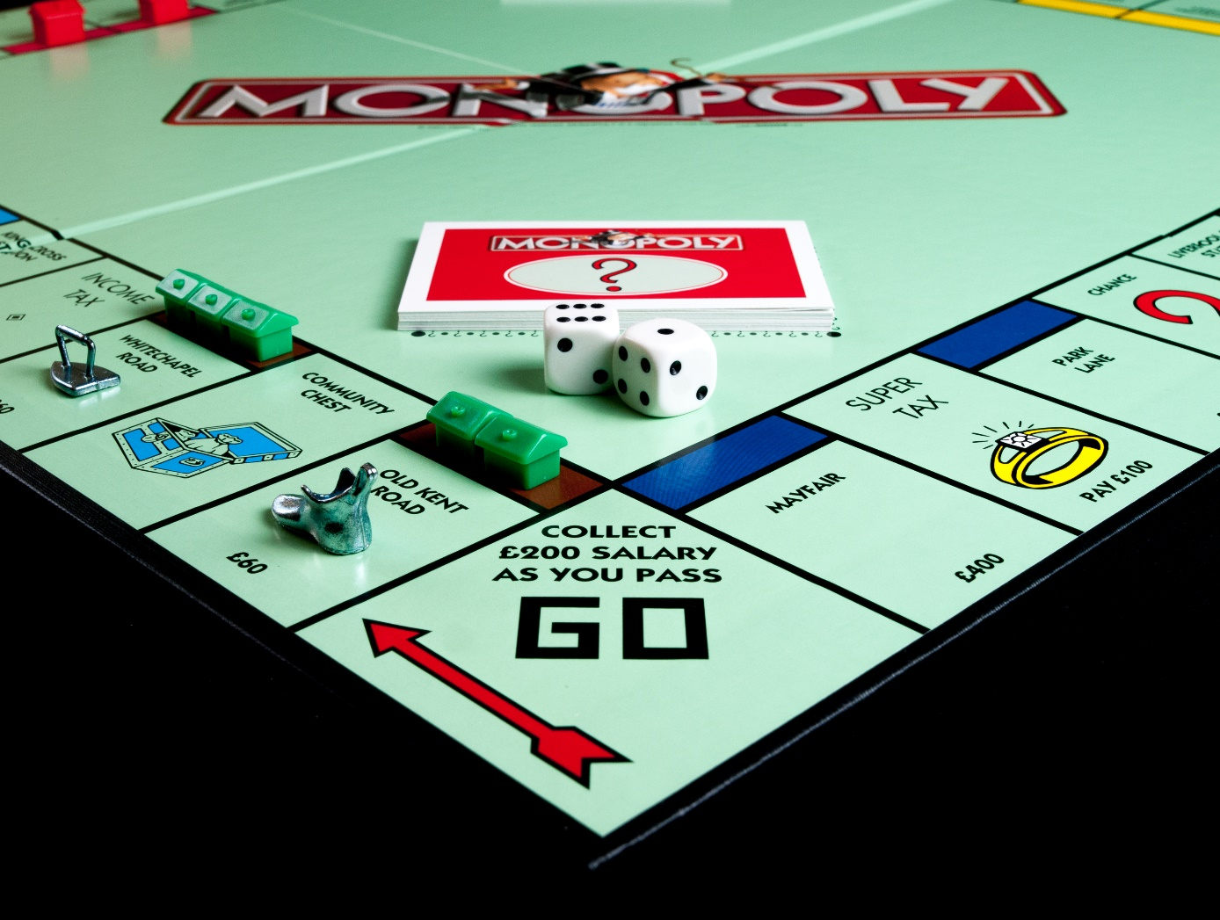
This is a highly abstract capitalism simulator

Slide 8
Abstraction

Slide 9
Abstraction is a kind of simplication
Removes irrelevant detail
If you’re playing a scene in a football stadium, you don’t need to decide the names, histories, and favorite ice cream flavors of all the people in the stadium
They’re just “fans”
Very important in analog games
Reduces cognitive load on players
Keeps the game from stopping dead every time you need to do something
Imagine if buying a property in Monopoly required you to fill out mortgage applications, get the building inspected and assessed, go through zoning, construction permits, bribing aldermen, deal with anti-money-laundering laws, …
Or if players literally had to keep account legers

Slide 10
Game mechanics are an abstracted simulation
Of whatever the game is about
What to simulate, and in how much detail, depends on
Is it an analog, digital, or hybrid game?
Who’s stuck handling the simulation?
What are the intended aesthetics of the game?
Fast or slow?
Strategic or casual?
Light or dark tone?

Slide 11
Example: damage in combat
Checkers: one hit kills
Hit points
Abstract, numerical measure of ability to absorb damage
Each successful attack reduces HP
Character dies when HP reduced to zero
HP+hit location (e.g. RuneQuest)
More detailed model
Hits in specific locations cause specific problems for the character
Also more cumbersome
Status effects (sleep, rage, poison, blindness, …)
Used in CRPGs
Fixed set of temporary afflictions that change the behavior of the simulation code (e.g. poison slowly depletes HP, rage decreases accuracy but increases damage)

Slide 12
Example: damage in combat (narrative focused)
Problem cards (e.g. GUMSHOE One to One)
Like story-specific status effects
Pre-authored descriptions of problems the player has as a result of the combat damage
Customized to the particular story world
Examples (if you get bitten by a vampire)
Bleeding: they can smell your blood and track you until you can stop the bleeding
They’ve tasted you: they will recognize your scent forever
Thrall: Wow. That felt good. Like, really good. Now you have to roll a saving throw anytime you see them to not ask them to bite you again
Consequences (Fate)
Like problem cards, except you make them up yourself, in consultation with the GM and other players
Can pick anything that makes sense and is narratively interesting

Slide 13
Distortion

Slide 14
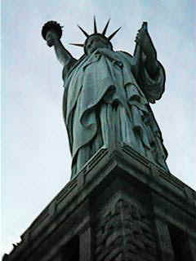
Distortion
Plato (The Sophist) pointed out that there are different kinds of imitative art
Faithful reproduction
Intentionally distorted in order to appear correct
Of course, in practice, this is a spectrum; no art is a perfect reproduction

Slide 15
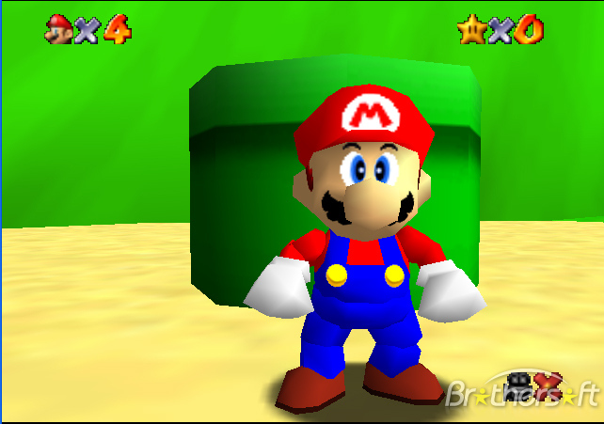
Realism and distortion in games
Games are usually highly distorted
Simplified
You don’t want SimCity to simulate the rusting of individual sewer valves
Made easier
In real life, you have one hit point
Made more real seeming
Random number generators are often tweaked to feel more random than actual randomness

Slide 16
Damage distortion
Traveler
Science fiction game franchise
Tries to have realistic combat
Weapon tech advances much faster than armor
Fighters have short life expectancies, no matter how skilled they are
Dungeons and Dragons™
You can absorb abstract damage (hit points)
Not particularly inconvenienced by it until you’re dead
Makes combat possible and rewarding
Star Wars films
Combat highly skewed in favor of protagonists
A teenage farmer can shoot better than the emperor’s elite combat troops

Slide 17
Realism isn’t a single dimension

Slide 18
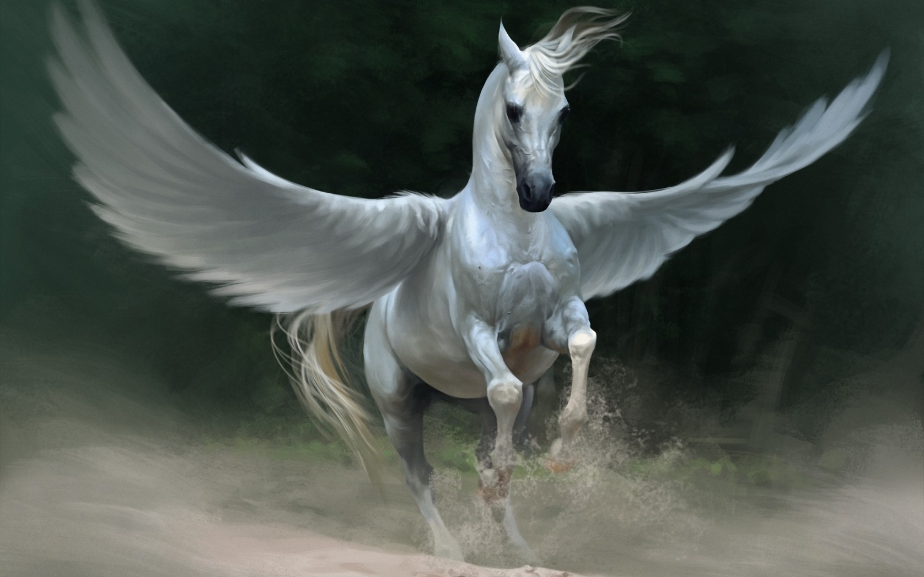
Is this realism?

Slide 19

How about this?

Slide 20
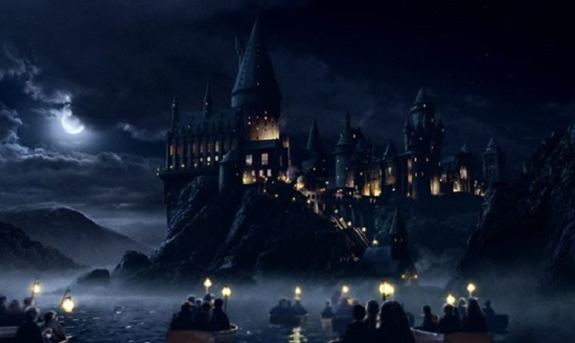
Or this?

Slide 21
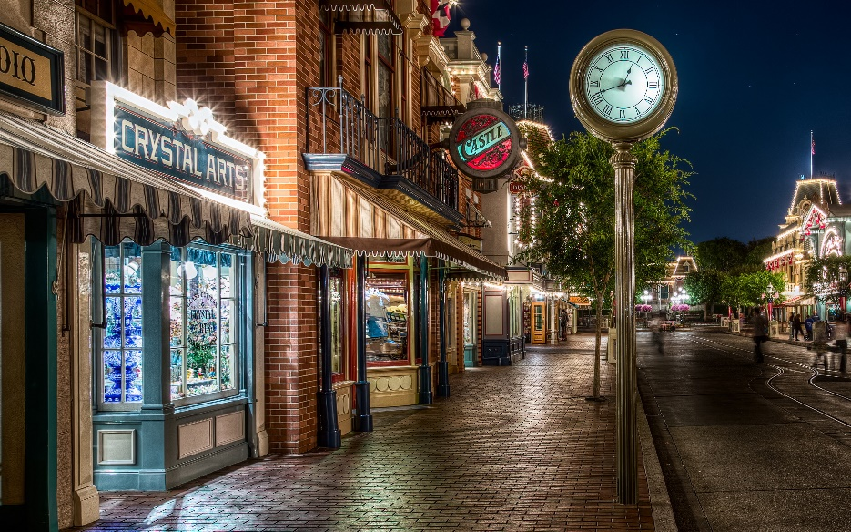
Hyperreality
Jean Baudrillard and Umberto Eco:
Disneyland’s Main St. is a fantastic, hyper-realistic simulation of old-time America
But it’s a simulation of a romantic ideal that never existed
No street in America ever actually looked ike that

Slide 22
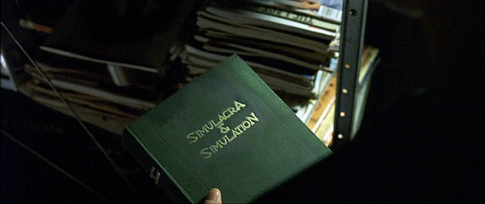
The Matrix

Slide 23
Lifeworlds

Slide 24
Lifeworlds
The world you live in as distinct from physics
The business world
The academic world
The Poker world
The music world
The literary world

Slide 25
Elements of a lifeworld
Care A lifeworld comes prepackaged with fears, goals, aspirations, and other values that it expects you to adopt
Staying alive
Getting promoted
Equipment A lifeworld is populated with objects, people, forces of nature, and so on, that all relate back to your concerns
Actions It provides you with the potential for meaningful action
Consequences It specifies the meaningful consequences of your possible actions

Slide 26
Games are lifeworlds
They’re like simulations of lifeworlds
They come prepackaged with care
Players make meaningful choices within them
But there might not actually be a thing being simulated, so perhaps the simulation just is the lifeworld

Slide 27
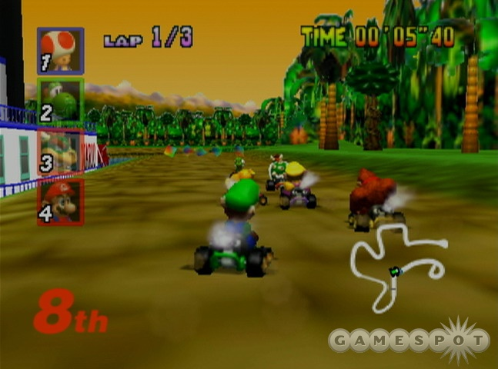
MarioKart 64 as a lifeworld
Care You want to get across the finish line before the other players
Equipment The track, your Kart, power ups, the finish line, other players
Actions Acceleration and braking, activating a powerup
Consequences The rules of the simulation

Slide 28
Games as formal systems

Slide 29
Games as formal systems
Take the rules for Monopoly
Replace all the capitalism words like “property”, “buy”, “pay”, “collect”, “rent” with their equivalent words in the Akkadian language of ancient Babylon
Teach the game to someone who
Speaks English
Hasn’t studied any Semitic languages
They are playing monopoly
But have no idea it’s about capitalism

Slide 30
Reskinning a game
Take Dungeons and Dragons™
Change all fantasy terms ⇨ Star Wars™ terms
Magic ⇨ force
Gold piece ⇨ credit
Horse ⇨ flying car
Orc ⇨ Gamorrean
Bow ⇨ laser carbine
Healing potion ⇨ bacta
Hit point ⇨ hit point
The mechanics (and so formal system) is exactly the same
And yet it will seem different to the players

Slide 31
Flavor text
Flavor text is evocative terminology
Backstory/lore
Setting-appropriate terminology for mechanical
But has no mechanical effects on the game
Games are roughly mechanics + flavor text

Slide 32
Games as semi-formal systems
Many tabletop games have rules that require interpretation
“Don’t bother to roll for something unless success and failure are both interesting”
That’s a rule
Fits into a formal system of other rules
But requires human-level understanding to apply it
Very hard for digital games
One reason tabletop games often have GMs
Need someone to interpret the rules

Slide 33
Story games as simulations

Slide 34
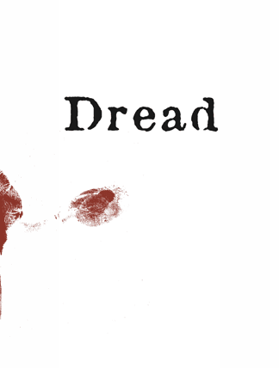
Story games are simulations of storytelling
They model
Genre
Characters
As distinct from people
Narrative focus
Keep the protagonists on camera!
The writing process
Strong biases in favor of narratively interesting outcomes

Slide 35
Story-centric game mechanics in Dread
The questionnaire
The character creation process focuses on adding backstory to the character that can be used within the game to dramatic effect
It’s providing resources for the characters, but they’re dramatic resources
The tower
Action resolution is performed by pulling blocks from a Jenga tower
Physicalizes the notion of rising stakes in the narrative
Death isn’t always death
When a player collapses the tower, their character is written out in a narratively appropriate way
That doesn’t have to mean they die
They may be arrested, go insane, be hospitalized, etc.

Slide 36
Story-centric game mechanics in Fiasco
Setup
Again, provides narrative resources
Designed to create an unstable situation among the characters
Scenes are resolved rather than actions
Resolution process determines whether the scene works out well or poorly for the protagonist
Then you improvise that outcome
Positive and negative outcomes are limited resources
You can’t have every scene be positive
Neutral isn’t a possible outcome: neutral is boring
Tilt table
Designed to introduce further instability
Aftermath
Specified general outcome for story for that character
Most outcomes are either good or bad
The more neutral ones are ambivalent

Slide 37
Story-centric game mechanics in FATE
Very abstract actions
Create advantage
Overcome obstacle
“Attack”
Not necessarily combat
You use this any time you try to overcome a sentient obstacle that can resist you
“Defend”
Resist someone trying to put you at a disadvantage
Aspects
General narrative resources you can call on during gameplay
FATE points
Resource you can use to be awesome
But depletable so everybody can’t be awesome all the time

Slide 38
Story-centric game mechanics in GUMSHOE
Mystery-oriented game system
Action resolution only when it’s interesting
Only performed when both success and failure are narratively interesting
Die rolls are not allowed to derail the story
Pool points
Character skills are a depletable resource
Using the same skill over and over makes for a boring story
Also, same character acting over and over makes for a boring story
So resource depletion forces the narrative spotlight to move around
Investigative actions
Always succeed, without a point spend
Because missing a clue would kill the story

Slide 39
Story-centric game mechanics in DramaSystem
Actions are emotional exchanges
A petitioner character seeks some emotional concession from a granter character
Granter player decides whether grant or refuse it
You play out the interaction accordingly
Exchanges are regulated by a point system
Must have a point to petition a character
If they grant it, you pay them a point
If they refuse it, they pay you a point
Enforces balance of grants and refusals on average

